Slide 1
Project Name
Flower Image Classification By Using Python

Slide 2
Group Members
MUHAMMAD QASIM ZAFAR
TAIMOR HASSAN

Slide 3
Main Objectives:
1. Accuracy: Develop a model that accurately classifies images into predefined categories.
2. Efficiency: Optimize the model for real-time or near-real-time performance.
3. Robustness: Ensure the model performs well across diverse image quality, lighting conditions, and orientations.

Slide 4
ABOUT DATASET
Flowers dataset
Dataset consist of 4317 images
Five classes
daisy has 764 Images
dandelion has 1052 Images
rose has 784 Images
sunflower has 733 Images
tulip has 984 Images
Each image is 180 by 180 pixels
Refrence:- Github

Slide 5
For training we take 3454 images.
Rest 863 images are used for validation.
The distribution of images will be done by writing ython code.

Slide 6
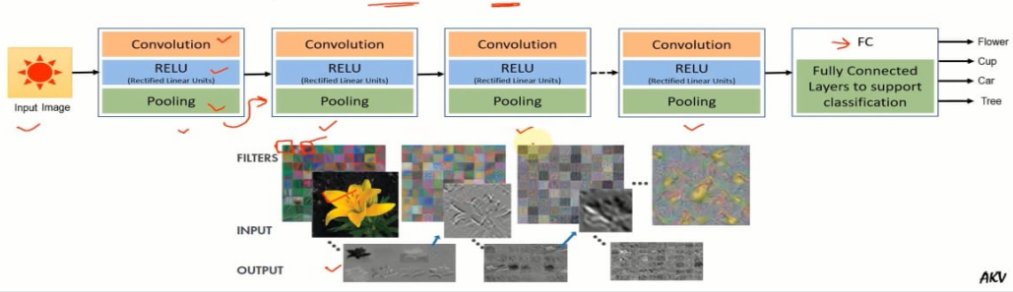
Structure of a convolutional Neural Network
One of the most popular types of deep neural networks is known as convolutional neural networks (CNN or ConvNet). A CNN convolves learned features with input data, and uses 2D convolutional layers, making this architecture well suited to processing 2D data, such as images.

Slide 7
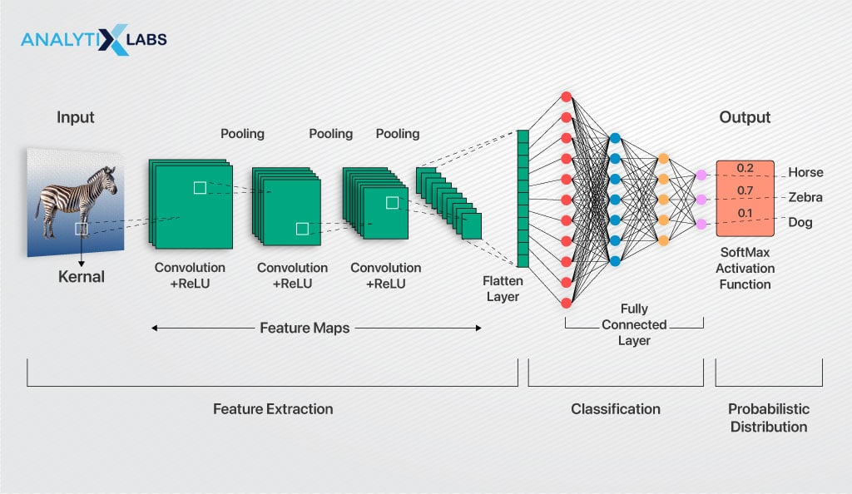
Layers of CNN

Slide 8
Layers Of CNN
Image Input Layer: This is the layer where we specify the image size.
Image input layer{[M N,n],Name input}
Image input layer{[180 180 3],Name input}
Convolutional Layer: It is main layer which is responsible of features extractions. Filters keep on updating 2,3 with training data. 1
Convolutional2dlayer:(Filtersize,numfilters,Stride,n,Padding,same,name,conv_1 )
Batch Normalization Layer: It normalizes the activations and gradients, making network training an easier optimization problem and speeds up network training and reduces the sensitivity to network initialization.
→batchNormalizationLayer('Name', 'BN_1')

Slide 9
Layers Of CNN
ReLU Layer: The most common non linear activation function is the Rectified Linear Unit (ReLU). reluLayer('Name','Relu_1')
Max Pooling Layer: It is down-sampling operation that reduces the spatial size of the feature map and removes redundant spatial information.
maxPooling2dLayer (PoolSize, 'Stride', n, 'Name', 'MaxPool_1')
Fully Connected Layer: The last fully connected layer combines the features to classify the images. fullyConnected Layer(outputSize, Name, Value) fullyConnectedLayer(10,'Name', 'FC')

Slide 10
Layers Of CNN
Softmax Layer: The softmax activation function normalizes the output of the fully connected layer. The output of the softmax layer consists of positive numbers that sum to one, which can then be used as classification probabilities by the classification layer.
softmaxLayer('Name', 'SoftMax')
Classification Layer: The final layer is the classification layer. This layer uses the probabilities returned by the softmax activation function for each input to assign the input to one of the mutually exclusive classes and compute the loss.
classificationLayer('Name', 'Output Classification')

Slide 11
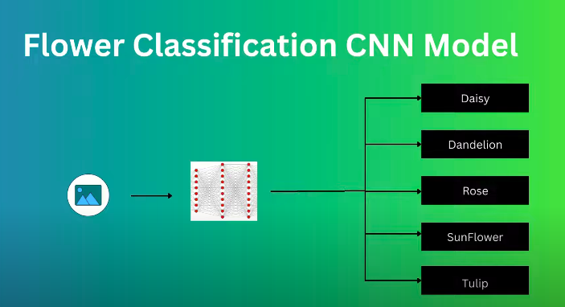

Slide 12
Thank you

